Slide 1
Describing Process Specifications,
Structured Decisions & Structured Analysis
Systems Analysis and Design
By: Isaac Tomusange

Slide 2
Major Topics
Process specifications
Business rules
Structured English
Decision tables
Decision trees
Horizontal balancing
9-<number>

Slide 3
Process Specifications
Process specifications are created for primitive processes and some higher level processes on a data flow diagram.
Process description tools (Decision trees, tables, structured English) document the details of a functional primitive in a precise & concise way.
9-<number>

Slide 4
Goal of Creating Process Specifications
The goals of producing process specifications are:
  Reduce process ambiguity.
  Obtain a precise description of what is accomplished.
  Validate the system design, including data flow diagrams and the data dictionary.
9-<number>

Slide 5
Process Specifications
Process specifications are not created for:
  Physical input and/or output processes.
  Processes that represent simple data validation.
  Processes for which prewritten code already exists.
9-<number>

Slide 6
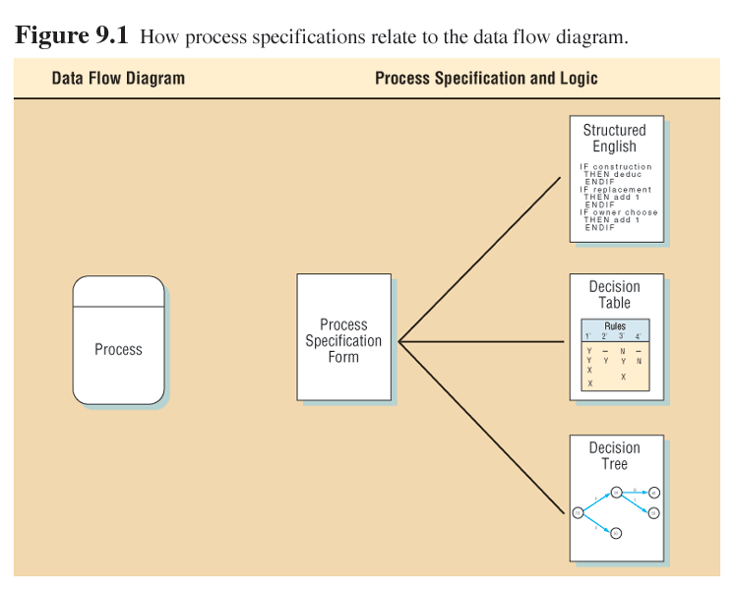
Data Flow Diagram and
Process Specifications
9-<number>

Slide 7
Process Specification Format
Process specifications link the process to the DFD and the data dictionary.
The following information should be entered:
  The process number, which must match the process ID on the data flow diagram.
  This allows an analyst to work or review any process and easily locate the data flow diagram containing the process.
9-<number>

Slide 8
Process Specification Format (Continued)
  The process name, the same as displays within the process symbol on the DFD.
  A brief description of what the process accomplishes.
  A list of input and output data flow, using the names found on the data flow diagram.
  Data names used in the formulae or logic should match the data dictionary, for consistency and good communication.
9-<number>

Slide 9
Process Specification Format (Continued)
  An indication of the type of process, whether it is batch, online, or manual.
  All online processes require screen designs.
  All manual processes should have well-defined procedures for employees performing the process tasks.
  If the process has prewritten code for it, include the name of the subprogram or function.
9-<number>

Slide 10
Process Specification Format (Continued)
  A description of the process logic.
  This should state policy and business rules, not computer language pseudocode.
  A reference to further information, such as a structured English description, a decision table, or tree depicting the logic.
  List any unresolved issues.
  These issues form the basis of the questions used for a follow-up interview.
9-<number>

Slide 11
Business Rules
Business rules include the following:
  Definitions of business terms
  Business conditions and actions
  Data integrity constraints
  Mathematical and functional derivations
  Logical inferences
  Processing sequences
  Relationships among facts about the business
9-<number>

Slide 12
Process Specification Example Part 1
Number 1
Name Add Customer Order
Description Key and add the Customer Order.
The order should be edited for correct information.
Customer and Item master files are updated.
Input Data Flow
Customer Order Form from the Customer
Customer Record from data store D1, Customer Master File
Item Record from data store D2, Item Master File
9-<number>

Slide 13
Process Specification Example Part 2
Output Data Flow
Pending Order to data store D3, Order File
Backordered Item Record to the Inventory Control Department
Updated Customer and Item records
Type of process Online
9-<number>

Slide 14
Structured English
Structured English is based on structured logic or instructions organized into nested & grouped procedures & Simple English statements such as add, multiply, move, and so on.
It is an appropriate technique for analyzing the system when structured decisions are not complex.
Describes logical processes precisely, concisely i.e. uses narrative statements to describe procedure.
9-<number>

Slide 15
Steps to Use Structured English
The following steps are needed:
  Express all logic in terms of sequential structures, decision structures, case structures, or iterations.
  Use and capitalize accepted keywords such as IF, THEN, ELSE, DO, and PERFORM.
  Indent blocks of statements to show their hierarchy (nesting) clearly.
9-<number>

Slide 16
Steps to Use Structured English (Continued)
Underline words or phrases used have been defined in a data dictionary to signify that they have a specialized, reserved meaning.
Be careful when using "and" and "or ”.
Avoid confusion when using logical comparisons such as "greater than" and "greater than or equal to”.
9-<number>

Slide 17
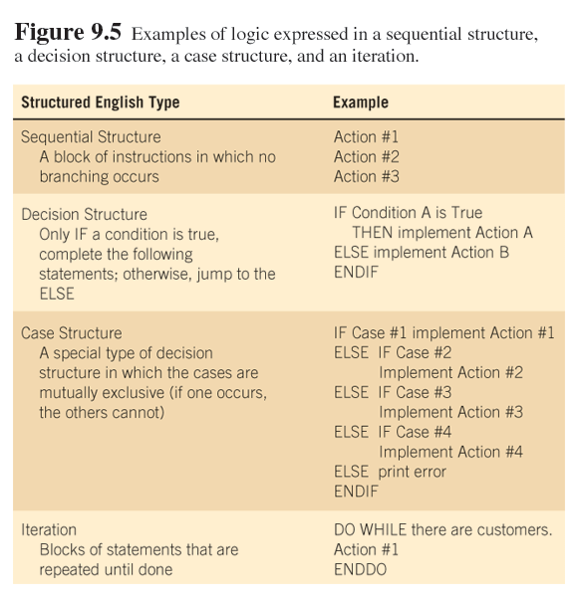
Structured English
9-<number>

Slide 18
Advantages of Structured English
Clarifying the logic and relationships found in human languages
An effective communication tool, and easy to teach and understand.
It shows sequence of decisions.
9-<number>

Slide 19
Data Dictionary and Structured English
The data dictionary is a starting point for creating structured English:
  Sequenced data dictionary entries become simple structured English statements.
  Selection [] entries become IF..THEN...ELSE statements.
  Iteration { } entries become DO WHILE, DO UNTIL, or PERFORM UNTIL structured English statements.
9-<number>

Slide 20
Decision Tables
A tabular description of a selection structure i.e. it’s a graphic method for describing the logic of decisions.
Decision tables provide a way to examine, describe, and document complex decisions.
They are used to:
  Describe the conditions.
  Identify possible decision alternatives.
  Indicate actions should be performed.
  Describe actions.
9-<number>

Slide 21
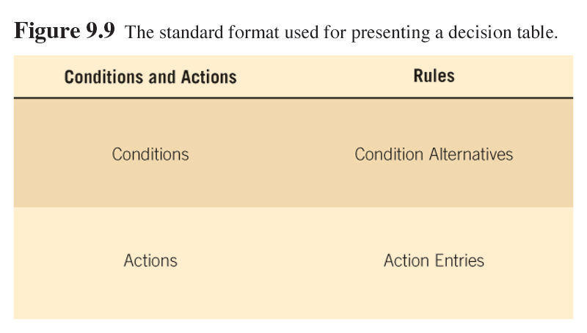
Decision Table Format
9-<number>

Slide 22
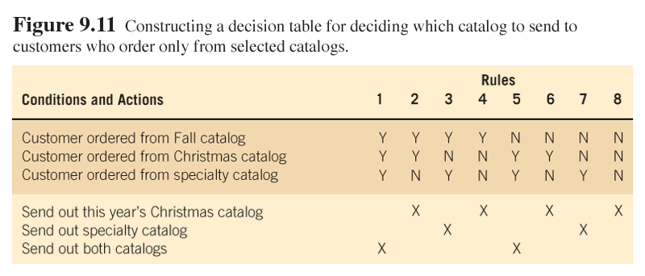
Decision Table Example
9-<number>

Slide 23
Decision Tables (Continued)
Decision tables help analysts ensure completeness and accuracy.
Four main problems that can occur in developing decision tables:
  Incompleteness.
  Impossible situations.
  Contradictions.
  Redundancy.
9-<number>

Slide 24
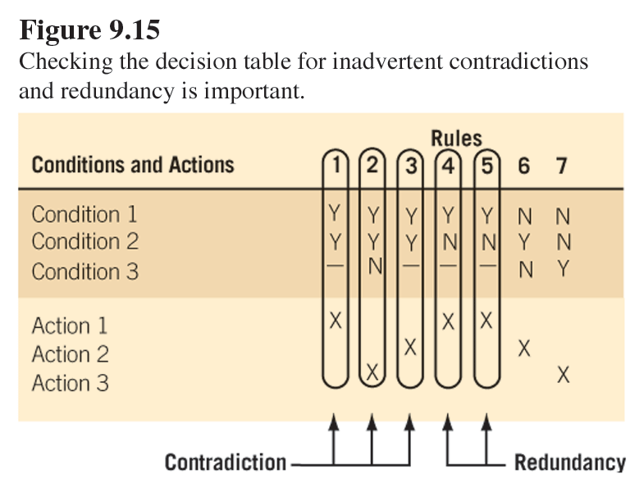
Redundancy and Contradictions
9-<number>

Slide 25
Advantages of Decision tables
Concise, unambiguous & clearly convey involved logic & there’s less danger of omitting logical possibilities.
Provide enhanced communication with actions separated from conditions.
Easier to draw & easily understood.
Produce an automated compact program documentation
9-<number>

Slide 26
Disadvantages of Decision tables
They don’t show sequence of decisions.
9-<number>

Slide 27
Decision Trees
A graphic representation of a selection structure
Decision trees are used when complex branching occurs in a structured decision process.
Trees are also useful when it is essential to keep a string of decisions in a particular sequence.
9-<number>

Slide 28
Drawing Decision Trees
First, identify all conditions and actions and the order and timing of these (if they are critical).
Second, begin building the tree from left to right while making sure you are complete in listing all possible alternatives before moving over to the right.
9-<number>

Slide 29
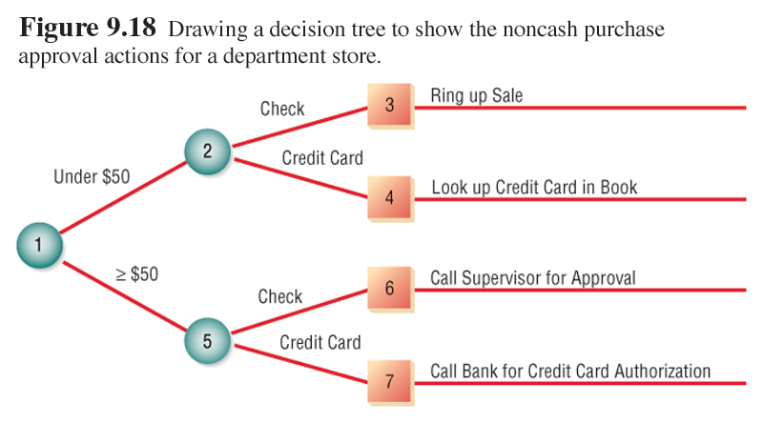
Decision Tree Example
9-<number>

Slide 30
Decision Tree Advantages
Three advantages decision tree over a decision table are:
  The order of checking conditions and executing actions is immediately noticeable.
  Second, conditions and actions of decision trees are found on some branches but not on others.
  Third, compared to decision tables, decision trees are more readily understood by others in the organization.
9-<number>

Slide 31
Selecting a Structured Decision Analysis Technique
Guidelines are as follows:
  Use structured English when there are many repetitious actions or when communication to end users is important.
  Use decision tables when complex combination of conditions, actions, and rules are found or you require a method that effectively avoids impossible situations, redundancies, and contradictions.
9-<number>

Slide 32
Selecting a Structured Decision Analysis Technique
  Use decision trees when the sequence of conditions and actions is critical or when not every condition is relevant to every action (the branches are different).
9-<number>

Slide 33
Structured Analysis
This deals with the logic of the system
It requires the analyst to define what the system should do i.e. breaking down the system into manageable sub-systems (method for defining system inputs, processes & outputs) that show a logical graphic model of information flow.
9-<number>

Slide 34
Structured Analysis
Objective: to document all the end-user requirements for the proposed IS & present the requirements in the systems requirements document.
It accomplishes the following
- view of the System from top to bottom.
- specifies the interfaces that exist between modules.
-Rigorously specifies the processes/transformations that occur within each module
9-<number>

Slide 35
Components of Structured Analysis
Data Dictionary: Description of all the data used in the system
Graphic symbols: icons & conventions for identifying & describing the components of a system & r/ship among the components.
Procedure & process description: formal statements using techniques & languages that enable the SA to describe important activities that make up a system.
9-<number>

Slide 36
Rules: standards for describing and documenting the system correctly & completely.
Data flow Diagrams (DFD): these show how data moves & changes through the IS in a graphical top-down fashion (i.e.a graphical representation of a system’s components processes & the interfaces between them.
9-<number>

Slide 37
Process Modelling (with DFDs)
DFDs are useful in modelling the scope of a system’s project in terms of its interfaces with other systems, the business as a whole & the outside world.
They show how data flows to, from and within an IS & the processes that transform data
They also show where data is stored.
9-<number>

Slide 38
Symbols for Drawing DFDs
Data flows ( ): show the movement of data between processes, external entities and data stores in a DFD.
Processes ( or ): portray the transformation of input data flows to output data flows in DFDs.
9-<number>

Slide 39
Symbols
Data Stores ( ): these are either manual or automated inventories of data e.g computer files/databases, file cabinets, card files, e.t.c
External entity ( ): are originators or receivers of information outside the scope of the IS portrayed in the data flowing
9-<number>

Slide 40
General Rules for Drawing DFDs
Any data flow leaving a process must be based on data input to the process.
All data flows are named & the names should reflect the data flowing between the processes, sources & data stores.
All the data needed to perform the process should be input to that process.
The process should be independent of any other in the system, therefore, each process has its own input & output.
9-<number>

Slide 41
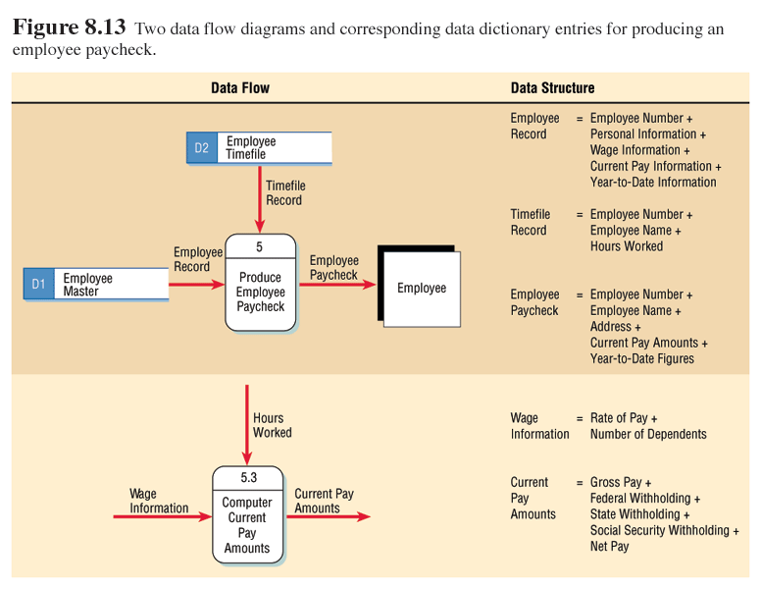
Data Dictionary and
Data Flow Diagram Levels
9-<number>

Slide 42
Data Dictionary and Data Flow Diagram Levels
Data dictionary entries vary according to the level of the corresponding data flow diagram.
Data dictionaries are created in a top-down manner.
Data dictionary entries may be used to validate parent and child data flow diagram level balancing.
9-<number>

Slide 43
Data Dictionary and
Data Flow Diagram Levels
Whole structures, such as the whole report or screen, are used on the top level of the data flow diagram.
  Either the context level or diagram zero
Data structures are used on intermediate-level data flow diagram.
Elements are used on lower-level data flow diagrams.
9-<number>

Slide 44
Context Diagram & Levelling
A simple DFD that depicts the system being studied as it relates to other systems, the business & outside world, i.e. the interfaces flowing to / from the external entities.
Levelling: a technique used to draw DFDs in various levels of detail, ranging from depicting an entire system’s big picture to showing the detailed processing of a single transaction.
9-<number>

Slide 45
Context Diagram (an order processing system)
order invoice orders data store
Order
Processing
system
Customer
9-<number>

Slide 46
Determining Data Store Contents
Data stores may be determined by analyzing data flows.
Each data store should consist of elements on the data flows that are logically related, meaning they describe the same entity.
9-<number>

Slide 47
Maintaining the Data Dictionary
To have maximum power, the data dictionary should be tied into other programs in the system.
When an item is updated or deleted from the data dictionary it is automatically updated or deleted from the database.
9-<number>

Slide 48
Using the Data Dictionary
Data dictionaries may be used to:
  Create reports, screens, and forms.
  Generate computer program source code.
  Analyze the system design for completion and to detect design flaws.
9-<number>

Slide 49
Program Process Specification
All the process specifications are consolidated for a computer program and are included in the specification packet given to the computer programmer.
Since they are developed for one process, the logic is easier to understand.
9-<number>

Slide 50
Horizontal Balancing
Horizontal balancing means that all output data flow must be either on input data flow or described in the process logic.
It is used to verify that each process has the required data dictionary entries defined and the formulas and logic necessary to produce the output.
9-<number>

Slide 51
Rules for Horizontal Balancing
Rules for horizontal balancing are:
  All base elements on an output data flow must be present on an input data flow.
  All derived elements on an output data flow must be either:
    Present on an input data flow, or
    Created by the process.
9-<number>

Slide 52
Data modelling using Entity Relationship Diagrams (ERDs)
Data entity: anything real or abstract about which the SA or organisation want to store data. Most entities correspond to persons, objects, events.
Data relationship: a natural association between entities. All relationships are further described by words/ symbols that indicate number of occurrences of one entity that can exist for a single occurrence of the related entity.
9-<number>

Slide 53
The data definition phase looks at requirements independently, performs data modelling, identifies entities, data elements & relationships. Data models therefore complement process models.
The selection phase identifies new files & databases to be designed, how much data to be automated, specifies form of data storage distributed or centralised) and how the relationships between data entities are to be designed.
9-<number>

Slide 54
Data modelling using ERDs
Customer
places
order
contains
products
9-<number>

